Slide 1

ICLR CROP DETECTION WINNING SOLUTION
Threshold (Team)
Alchemi & DrFad

Slide 2
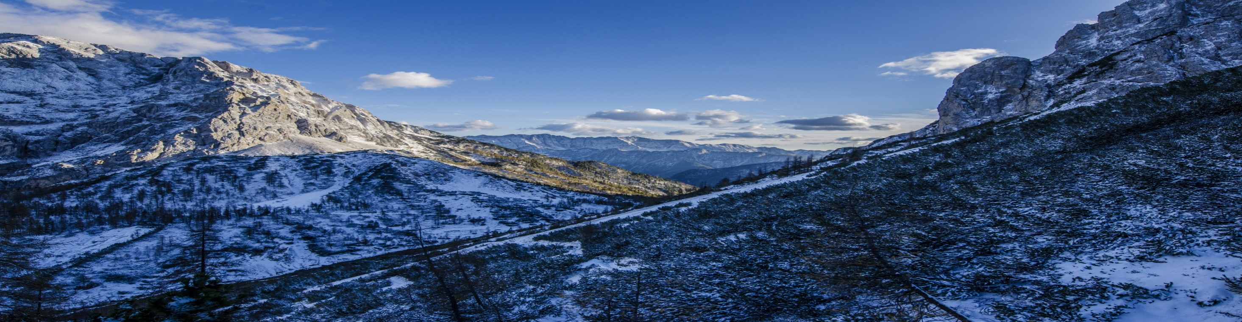
Model Architecture
The winning solution consists of 5 models ensembled with different weights
Data extraction
Models
Weights | output
Ensemble
DataFrame Generation.ipynb
Py
R
ICLR_Submit_Feb2804_opt_1.1833.rmd
X 1
1.2168…
2
ICLR_Submit_Feb2804_opt_1.1833.csv
1
completed data.csv
9
completed data.csv
R
ICLR_Submit_SMOTE_QhCpzd44_1700.rmd
X 1
R
ICLR_ensemble.rmd
1.3504…
4
ICLR_Submit_SMOTE_QhCpzd44_1700.csv
5
ICLR.rda
R
ICLR quantiles.rmd
Py
Team0.9to1R0_0.85to1_567Maxto1
(First Model - 1.148.ipynb)
8
X 2
1.4527…
1.171926…
Team 0.9to1R0 0.85to1 567Maxto1.csv
Final LogLoss
ICLR_qt8.rda
Py
Band_GE_0.9to1Rto0_0.85to1_Max56to1R0
(Second Model - 1.161.ipynb)
7
X 2
1.3597…
R
ICLR_python_train.rmd
3
Band GE 0.9to1Rto0 0.85to1 Max56to1R0.csv
R
ICLR_Catboost_1700_1.1603.rmd
X 1
1.1891…
Output files are:
test ICLR.csv
train ICLR.csv
ICLR_Catboost_1700_1.1603.csv
6
NB: When running step 4. After producing ICLR.rda, run step 5 and produce ICLR_qt8.rda, go back to step 4 and run completely

Slide 3
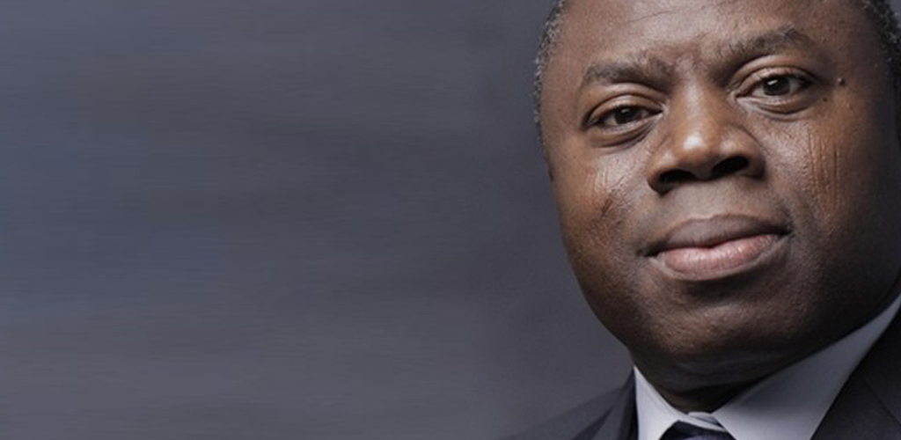
THANK YOU
Alchemi & DrFad

